Slide 1
Geotechnical aspect of opensees
Presented by
Jubin kumar soni

Slide 2
Geotechnical Problems that can be solved using OpenSees
Static Problems
Deformation analyses (1D, 2D, or 3D)
Consolidation problems (diffusion problems)
Soil-structure interaction problems
Shallow foundations (e.g. bearing capacity, settlements)
Pile foundations (e.g. vertical and lateral capacity)
Dynamic (earthquake problems)
Free-field analysis
Liquefaction induced problems
Soil structure interaction problems (e.g. response of pile

Slide 3
parameters we need??
Solid elements to characterize the soil domain
(continuum).
Appropriate boundary conditions to accurately
represent the soil domain boundaries.
Robust constitutive models to characterize the
soil stress-strain response under monotonic and cyclic loading conditions
Interface elements to capture the interaction
between the soil and adjacent structures.

Slide 4
Outline
Finite Elements (for solids)
Single-phase
Multi-phase (coupled) finite elements
Zero length element
Material Models
Elastic
Elasto-plastic Continuum Models
Elasto-plastic Uniaxial models
Boundary Conditions
Equal DOF
Absorbent boundaries

Slide 5
Finite Elements (solids)
Single-phase formulations
To capture the response of dry soils (or total
stress analysis) →need one single phase
Phase 1 – soil skeleton
Multi-phase formulations
To capture the response of saturated soils
(effective stress analysis) → need two phases
Phase 1 → soil skeleton
Phase 2 → pore water
Zero-Length element
To capture interface response between solid
and beam elements, and to apply absorbent
boundary conditions

Slide 6
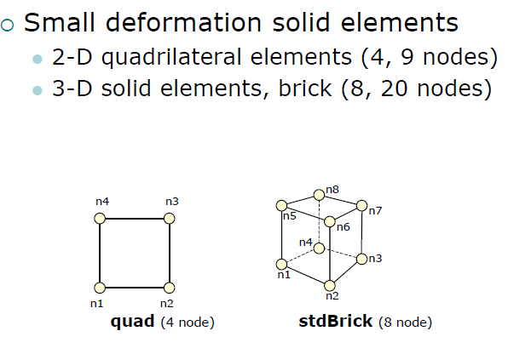
Single phase formulations

Slide 7
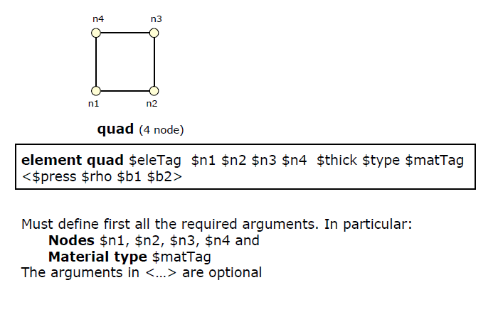
Quad element

Slide 8
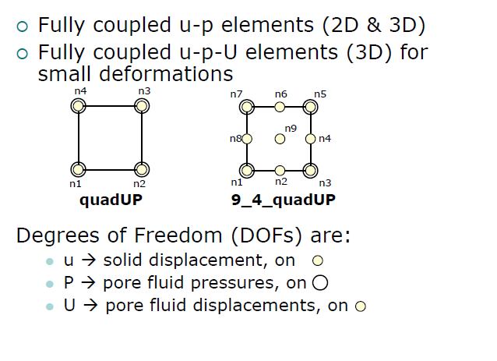
Multi phase formulations

Slide 9
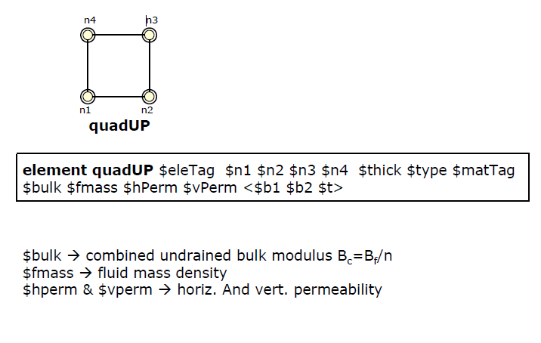
Quad UP element definition

Slide 10
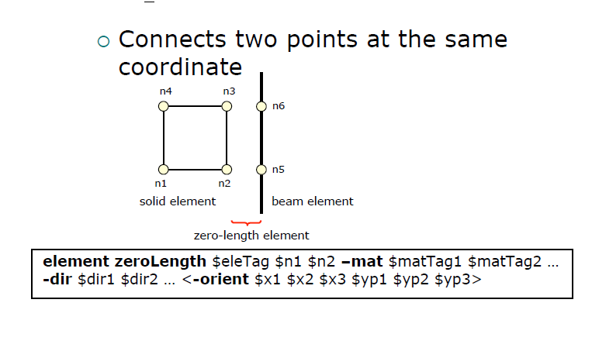
Zero length element

Slide 11
Material models
Linear Elastic Material model (nDMaterial)
To characterize the response of the soil (or other continuum) in its elastic state
Elasto-Plastic Material models (nDMaterial)
To characterize the nonlinear stress-strain
response of soils
Elasto-plastic Uniaxial models
To characterize the interface response between soil and structural elements (uniaxialMaterial).

Slide 12
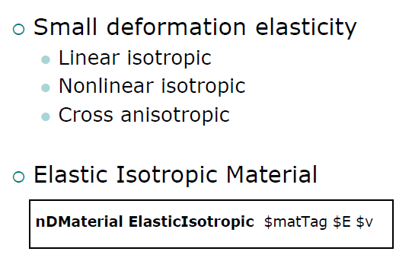
nDMaterialElastic

Slide 13
nDMaterial Elasto-Plastic
J2-Plasticity Material (von Mises)
Drucker-Prager Material (UW)
Cam-Clay Material (Berkeley, UW)
MutiYield Materials (San Diego)
FluidSolidPorous Material(SanDiego)

Slide 14


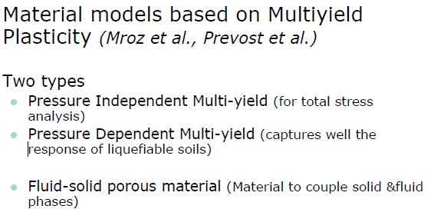
nDMaterial J2Plasticity

Slide 15
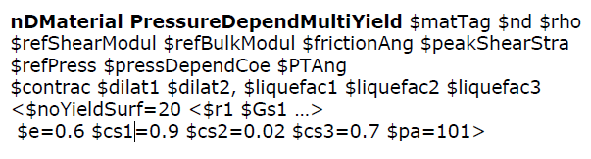

nDMaterial PressureDependentMultiYield
Some tables are available in opensees where for different types of soils parameters are already given

Slide 16
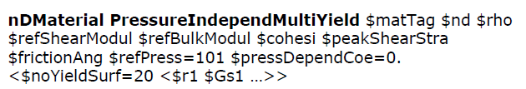
nDMaterial PressureIndependentMultiYield
For this also some tables are available in opensees where for different types of soils parameters are already given

Slide 17

nDMaterial FluidSolidPorousMaterial
Couples the response of two phases
(i.e., fluid and solid) – developed to simulate the response of saturated porous media

Slide 18
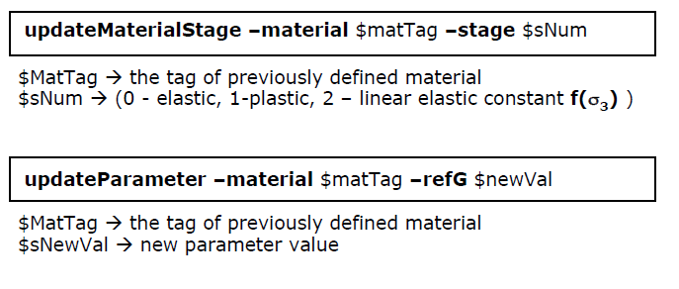
Additional commands for multiyieldmaterials

Slide 19
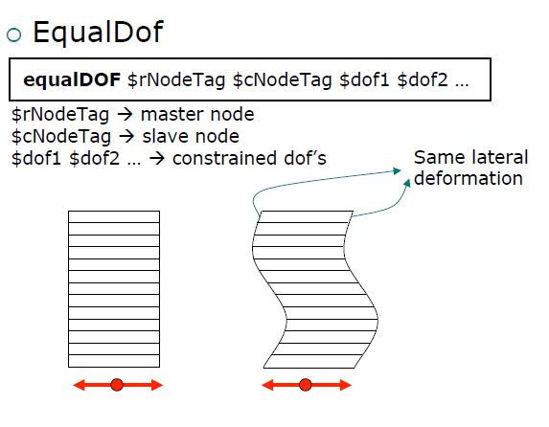
Boundary condition

Slide 20
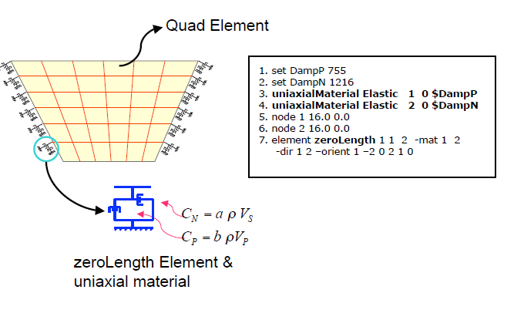
Absorbent/transmitting Boundaries

Slide 21
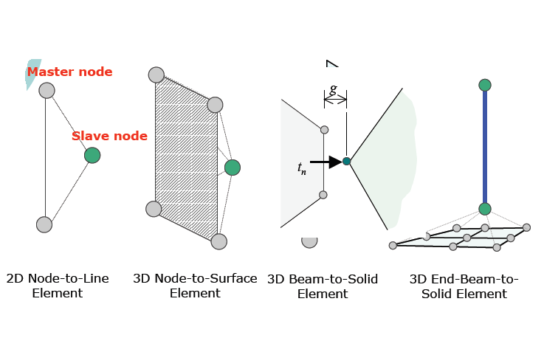
Contact elements available in opensees

Slide 22
